Slide 1
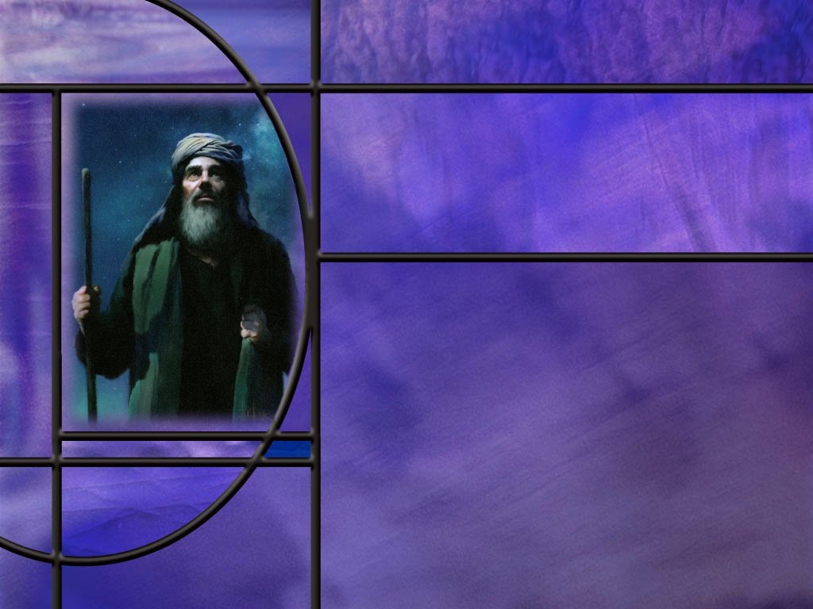
The Promise:
God’s Everlasting Covenant
Lesson 4
An Everlasting Covenant

Slide 2
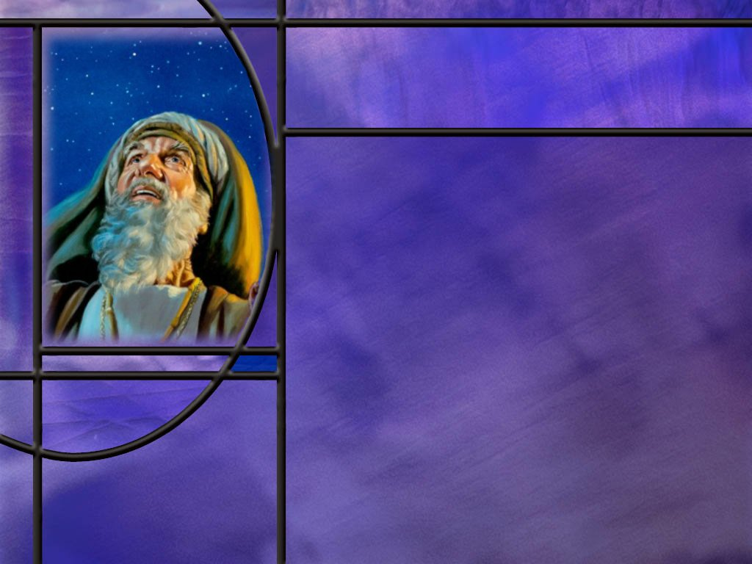
Memory Text
Genesis 17:7 RSV
And I [God] will establish my covenant between me and you [Abraham] and your descendants after you throughout their generations for an everlasting covenant, to be God to you and to your descendants after you.
Who did God intend to be the parties to this covenant?
What was God’s intent for the duration of this covenant?
How does this covenant, called “AN everlasting covenant” relate to “THE everlasting covenant” of salvation by grace through faith?
Notes:
B2:
1. It was to be between God on one hand and Abraham and his descendants on the other.
2. Again, here God refers to it as “my covenant.”
3. God determined the promises and the obligations of the covenant agreement.
4. And Abraham had a choice as to whether or not he would agree to it.
5. Would this covenant exclude those who were not Abraham’s descendants?
6. Yes. It appears that it does.
7. God is here choosing a specific group of people with whom to work and promising blessings to that group of people if they keep His covenant.
B3:
1. It was to be an everlasting covenant.
2. God did not set a terminal date.
3. As long as Abraham’s descendants continued to follow the covenant obligations, God would continue to keep His promise of blessings specified in this covenant.
B4:
1. Remember in Lesson 2 we talked about “The Everlasting Covenant.”
2. The writer to the Hebrews connects the everlasting covenant to the blood of Jesus.
Hebrews 13:20 NLT - Now may the God of peace--who brought up from the dead our Lord Jesus, the great Shepherd of the sheep, and ratified an eternal covenant with his blood--
3. It was the blood of Jesus that ratified the everlasting covenant of salvation.
4. Jesus was foreordained to be the Lamb slain from the foundation of the world.
5. It was before mankind sinned that the everlasting covenant was made.
6. It was made in the councils of heaven between Father and Son and witnessed by the Holy Spirit.
7. It was a covenant between Father and Son that would be put into effect if man chose to sin.
8. The plan was that Jesus, the Creator, would become man, the created.
9. He would become the second Adam, the head of a new humanity.
10. He would live in obedience to His Father and become the sinless Substitute for mankind.
11. He would die in our place paying the penalty for our sins and redeem us from the curse of sin.
12. All those who would repent, receive Him as their Savior and Lord, and trust in His blood would be forgiven.
13. The promise of this everlasting covenant was salvation to all who would receive the grace of God by faith in God’s forgiveness through Christ our Substitute.
14. The everlasting covenant provides “substitutionary atonement” from the first sin in Eden to the last sin at the end of time.
15. The covenant with Abraham that we study this week is not THE everlasting covenant of salvation.
16. It is a covenant added to the everlasting covenant by which God promises specific blessings to Abraham and his descendants and expects them to keep certain obligations.
17. This is God choosing to work through a specific group of people to keep the knowledge of God alive and provide access to the everlasting covenant of salvation for “whosoever will.”
18. It is through the everlasting covenant of salvation that God would call out a people of faith that would be His treasured possession and would surrender to Him and love Him supremely as their God.

Slide 3
Overview
In order to preserve a knowledge of God in an increasingly sinful world, God made a three-stage covenant with Abraham and his descendants to be His chosen people through which God could make His everlasting covenant of salvation available to mankind.
  Names of God
  Names, Meanings, and Changes
  Abrahamic Covenant
  Summary

Slide 4
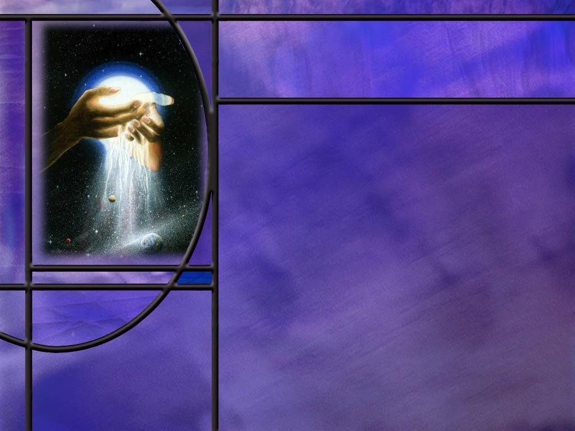
Names of God
How did the Lord reveal His name to Abraham in Gen 15:7?
How did God later identify himself to Moses at the burning bush? (Ex 3:13-15)
What name does God use for Himself when He makes a covenant with Abraham in Genesis 17:1?
Recognizing “El” as a name for God, what Bible names can you think of that include these two letters together?
Notes:
B1:
[See notes on linked slide.]
B2:
[See notes on linked slide.]
B3:
[See notes on linked slide.]
B4:
1. El Shaddai: “God almighty”
2. Elohim: "supreme one" or "mighty one,“ actually a plural form of El
3. El Elyon: “The Most High God.”
4. El Olam: “The Everlasting God.”
5. Emmanuel: “God with us.”
Angel and Human names:
1. Michael
2. Gabriel
3. Samuel
4. Nathaniel
5. Joel
6. Elkanah
7. Elijah
8. Elisha
9. Many others.

Slide 5
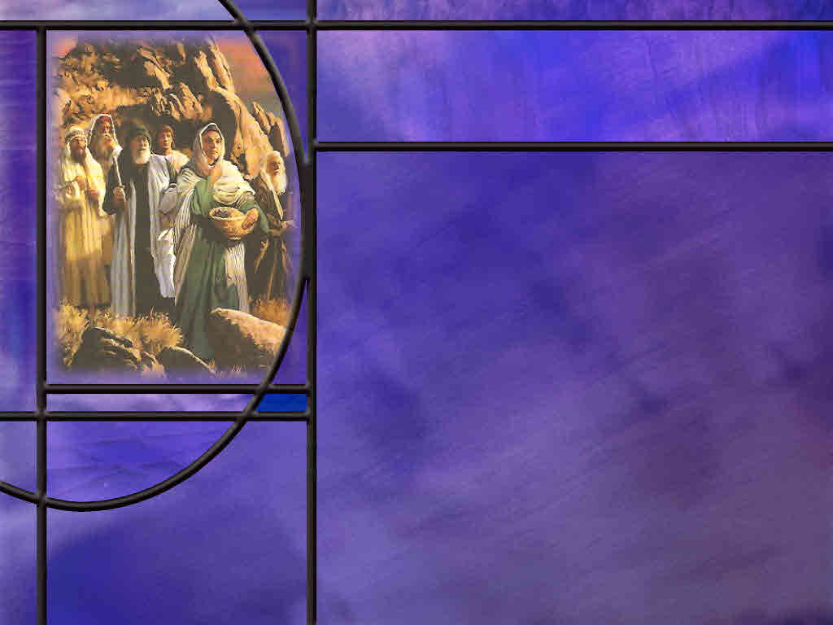
Names and Meanings
How did the importance of names in Bible times differ from their importance in our society today?
How did Mary and Joseph choose the name Jesus?
What did the name Jesus mean?
Are you aware of the meaning of your own name or of the names you gave to your children?
Notes:
B1:
1. In Bible times, names were considered to be much more important that in our society today.
2. Names were often given to reflect a parent’s desire for their child.
3. In some cases, the name reflected thanks to God for the gift of the child.
4. The name Nathaniel means “gift of God.”
5. The name Michael means “who is like God?”
6. The name Daniel means “God is my judge.”
7. The name Samuel means “God heard.”
8. How appropriate, because his mother Hannah was praying at the temple when Eli the priest thought she was drunk, but God heard her prayer and gave her a son.
B2:
1. They didn’t have much of a choice.
2. They were told by the angel Gabriel what His name was going to be.
Matthew 1:21 KJV And she shall bring forth a son, and thou shalt call his name JESUS: for he shall save his people from their sins.
B3:
1. The name Jesus means “Yahweh saves” or “Yahweh is salvation.”
2. But Jesus is the Latinized version of the Greek version of the original name given to Jesus.
3. In Hebrew, Jesus’ name was Yehoshu’a, from which we get Joshua.
4. In Aramaic, His name was Yeshu’a, from which we also get Joshua.
5. Transliterating either of those into Greek, the language of the NT, gave “Iesous.”
6. In Latin, this became Iesus and later (around 1500 AD) Jesus with the Jay sound.
7. So in His native language, Jesus’ name was Yeshu’a meaning Yahweh saves.
B4:
1. Kenneth is an old Irish name meaning fiery and fair or handsome.
2. My middle name is John which has alternated from first to middle name for several generations in our family. John is a Bible name that means “God is gracious.”
3. In naming our children, we didn’t really focus much on the meaning of the name.
4. It was more thinking of a name that would be popular but not too common or naming after a relative.
5. Parents usually want to make sure the name would not cause teasing or bullying.
6. My Dad’s middle name was Gaylord, not a very popular name today for obvious reasons.
7. No one would name their kid Judas or Adolph.
8. How about nicknames?
9. Sometimes nicknames were more reflective of something meaningful about you than your given name.
10. I remember a certain kid that sucked his thumb well into the first grade.
11. He ended up with the nickname “Sucky.”
12. Still as a teenager, everyone referred to him as “Sucky Harpster.”

Slide 6
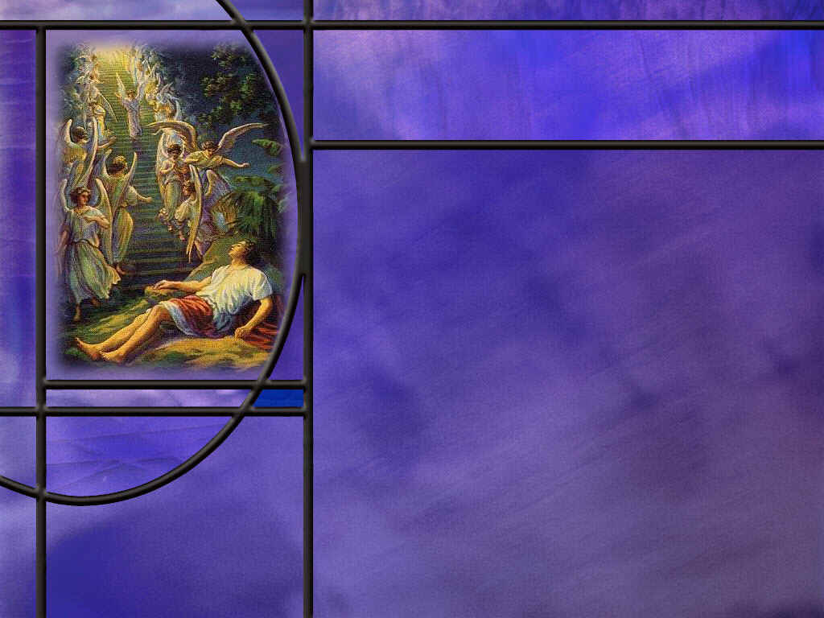
Names and Changes
How old was Abraham and how many children did he have when God changed his name?
What did the name change signify?
  Abram = exalted father;
  Abraham = father of many.
  Sarai = contentious
  Sarah = princess
What other examples can you remember of people’s names in the Bible that were changed?
What was the significance of a name change?
Notes:
B1:
1. Abraham was 99, Sarah was 90.
2. They had no children of their own.
3. It was not that they hadn’t tried; Sarah was barren.
B2:
1. Abraham’s name was a continual reminder of his covenant with El-Shaddai
2. To be the father of many, he certainly needed God almighty to intervene.
3. God’s new name for Abraham and Sarah were an indication of His expectations for them.
4. With God’s help, this is what they could become.
5. If they were faithful to God and His covenant, He would bless them and make them a blessing.
6. He would fulfill their dreams and aspirations.
7. He would be their God and they would be the first of God’s chosen people.
B3:
1. In the NT we have:
Saul to Paul
Simon to Peter
2. In the OT we have:
Jacob to Israel
Joseph to Zaphenath-Paneah
Daniel to Belteshazar
Hananiah to Shadrach
Mishael to Mishach
Azariah to Abednego
B4:
1. When God changes a name, it is an indication of the character or mission to which He wants you to aspire.
2. Jacob the deceiver was changed to Israel the overcomer.
3. Simon the listener was changed to Peter the stone.
4. Saul a Hebrew name was changed to Paul a Roman name.
5. Paul’s Roman name fit his mission to the gentile world.
6. Other name changes often reflected a change in cultural surroundings or status.
7. Pagan kings would give pagan names to help assimilate Hebrews into their pagan cultures.
8. Do you think God may have a new name for those who are born again?
Revelation 2:17 KJV He that hath an ear, let him hear what the Spirit saith unto the churches; To him that overcometh will I give to eat of the hidden manna, and will give him a white stone, and in the stone a new name written, which no man knoweth saving he that receiveth it.

Slide 7
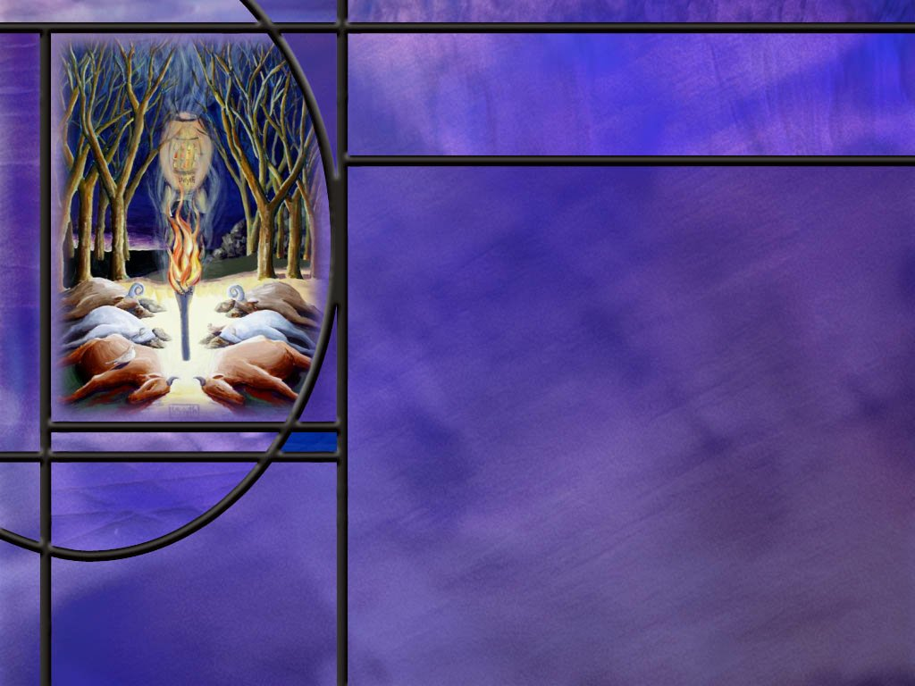
Abrahamic Covenant
What were the promises and obligations of the first stage of the covenant found in Gen 12:1-3?
What were the promises and obligations of the second stage of the covenant found in Gen 15:5-18?
What was the significance of passing between dead animals cut in two?
What were the promises and obligations of the third stage of the covenant found in Gen 17:1-14?
What eventually happened to the rite of circumcision? (1 Cor 7:19, Gal 5:6;6:15)
What other obligations were expected of Abraham according to Genesis 18:19?
Notes:
B1:
[See notes on linked slide.]
B2:
[See notes on linked slide.]
B3:
1. In Hebrew, the proper term for making a covenant between two parties was to “cut a covenant.”
2. That term was derived from the practice described here of sacrificing these animals and cutting them in two.
3. The SDA Bible commentary describes the significance of this ritual in these words:
“Those entering into the covenant were to walk between the divided pieces, symbolically vowing perpetual obedience to the provisions thus solemnly agreed upon. The lives of the animals pledged the lives of those participating in the covenant.”
4. So the vow was, “May I be as dead as these animals if I do not keep my promise in this covenant.”
B4:
[See notes on linked slide.]

Slide 8
Summary
Before creation, God established an everlasting covenant between Father and Son in the councils of heaven that would provide a means of salvation by grace through faith should mankind choose to sin.
Other covenants made by God with individuals or groups were designed to preserve the truth and knowledge of God in a sinful world and provide the best opportunity for people to discover the everlasting covenant and be reconciled to God by the forgiveness of their sins through the substitutionary atonement of Christ.
The Abrahamic covenant is revealed in three stages occurring at three different times.

Slide 9
Summary
Major promises of the covenant included: Abraham would have a miracle son with Sarah in their old age and his descendants would be as numerous as the stars, his descendants would receive the land of Canaan as their home, and through his descendants, all nations on earth will be blessed.
Abraham’s obligations included trusting the Lord and his promises, leaving his home in Ur for an unknown destination, following the Lord’s instructions for ratifying the covenant with blood, receiving circumcision as a sign of the covenant for all of his family and descendants, doing what is right and Just, and obeying God’s commandments, decrees and instructions.

Slide 10
Summary
Names in the Bible often signify the character or characteristics that parents desire to see in their children.
God’s names too have great significance: YHWH: the ever present I AM, the eternal self-existent One. El-Shaddai: the all-sufficient, all-bountiful, all-powerful One.
Such a God could make good on the covenant promises to Abraham, and God changed Abraham’s name as a reminder that God will make good on His covenant promises.
Will you stand with Abraham today as one who believes the word of God, trusts His promises, receives the everlasting covenant of salvation in Christ, and aims to live in obedience to His commandments?

Slide 12
Genesis 15:7 KJV
And he said unto him, I am the LORD that brought thee out of Ur of the Chaldees, to give thee this land to inherit it. [R]
Notes:
Q1: Now if you read the actual Hebrew text for this passage, what would you find for the word LORD?
1. You would find four Hebrew letters: YHWH, which today we would pronounce Yahweh.
2. When the Hebrews wrote, they wrote only the consonants, no vowels.
3. Well, how do you pronounce something with no vowels? You can’t.
4. But apparently, the pronunciation was handed down by word of mouth.
5. Much later, around 600 AD, a groups of scholars and copyists called the Masoretes added vowel markings to indicate how the text was usually read.
6. The vowel “pointings” were little markings usually below the consonant letters that indicated what vowels to use.
Q2: So why did they translate YHWH into LORD?
1. Well, the Hebrew scribes felt that the name of God was too holy to pronounce.
2. Nobody wanted to blaspheme God by mispronouncing His proper name.
3. So when they came to YHWH, the reader would say another name rather than pronounce the sacred personal name of God.
4. In English translations, this comes across as using all capitals to spell LORD rather than YHWH.
5. In Hebrew, after vowel pointings were introduced, they substituted the vowels for Adonai, meaning “Lord,” between the consonants for Yahweh.
6. This made it be pronounced in Hebrew as “Yahowah” which they knew was not the right pronunciation.
7. This came over into English as Jahovah or Jehovah.
8. Scholars believe the best pronunciation of YHWH is Yahweh, although we cannot be certain.
9. Almost all translations use LORD to translate YHWH.
10. A few, like the American Standard Version use Jehovah.

Slide 13
Exodus 3:13-15 NIV
Moses said to God, "Suppose I go to the Israelites and say to them, 'The God of your fathers has sent me to you,' and they ask me, 'What is his name?' Then what shall I tell them?" 14 God said to Moses, "I AM WHO I AM. This is what you are to say to the Israelites: 'I AM has sent me to you.' " 15 God also said to Moses, "Say to the Israelites, 'The LORD, the God of your fathers--the God of Abraham, the God of Isaac and the God of Jacob--has sent me to you.' "This is my name forever, the name you shall call me from generation to generation. [R]
Notes:
Q1: How does God identify himself to Moses here?
1. He identifies himself by two names: “I AM” and “Yahweh.”
2. We get Yahweh from LORD in verse 15.
3. And He explains them both by saying, “I AM who I AM.”
Q2: What do you think God is saying here about himself?
1. He is the one who always is.
2. He is the ever present, self-existent, ever living God.
3. He always has been, always will be; He has no beginning, no end.
4. Both I AM and YHWH are forms of the same verb, “to be.’
5. The Hebrew word for “I AM” is “haya” (haw-yaw) which is the Hebrew verb “to be.”
6. The third-person form of the verb “to be” is “he is.”
7. And it is the third person form of this verb that becomes Yahweh.
8. When God says His name, He says “I AM.”
9. When Moses says His name, he can say, “He is.”
10. Or when He quotes God, he can say God says His name is “I AM.”
11. So the name Yahweh is intended by God to signify God saying “I AM” to the people.
12. He is the ever present, self-existent, eternal God.

Slide 14
Genesis 17:1 NKJV
When Abram was ninety-nine years old, the LORD appeared to Abram and said to him, "I am Almighty God; walk before Me and be blameless.” [R]
Notes:
Q1: What Hebrew words are translated to give us “Almighty God?”
1. The two Hebrew words are “El” meaning God, and “saday” (shad-dah'-ee (Key)) meaning almighty.
2. So in this text we would say Shaddai El: Almighty God.
3. More commonly we would say El Shaddai: God almighty.
Q2: What happened to Abraham when he was 99 years old? What promise did God make to him?
1. The promise was that even though he was an old man married to an old woman, who at 90 was past the child bearing years and barren at that, that he would have a son by her.
Q3: Why, in that circumstance, would God use this particular name for Himself?
1. To believe that promise, Abraham needed to be reminded that he served an almighty God.
2. Only such a God could fulfill such a promise.

Slide 15
Genesis 12:1-3 NKJV
Now the LORD had said to Abram: "Get out of your country, From your family And from your father's house, To a land that I will show you. ² I will make you a great nation; I will bless you And make your name great; And you shall be a blessing. ³ I will bless those who bless you, And I will curse him who curses you; And in you all the families of the earth shall be blessed.“ [R]
Notes:
Q1: What are the promises of Stage 1 of the Abrahamic covenant.
1. These are basically promises of blessing that God would give to Abraham and his descendants.
2. God would make him a great nation.
3. God would bless him and make his name great.
4. God would make Abraham a blessing.
5. God would bless those who blessed Abraham.
6. And finally, God would bless all families of the earth through Abraham.
7. We understand this final promise to be fulfilled through Abrahams most famous descendant, Jesus of Nazareth.
8. It is Jesus who died for the sins of the world and offers to bless those who receive Him with eternal life.
Q2: What was Abraham’s obligation in receiving this covenant?
1. He had to exercise faith in Yahweh to lead him to a new land, and he had to obey the voice of the Lord to move out, not knowing where he was going.
Hebrews 11:8 NKJV - By faith Abraham obeyed when he was called to go out to the place which he would receive as an inheritance. And he went out, not knowing where he was going.
2. It took faith to trust that God would lead him to the right place.
3. And his obedience proved that his faith was genuine.

Slide 16
Genesis 15:5-6, 17-18 NKJV
Then He brought him outside and said, "Look now toward heaven, and count the stars if you are able to number them." And He said to him, "So shall your descendants be." ⁶ And he believed in the LORD, and He accounted it to him for righteousness. ... 17 And it came to pass, when the sun went down and it was dark, that behold, there appeared a smoking oven and a burning torch that passed between those pieces. ¹⁸ On the same day the LORD made a covenant with Abram, saying: "To your descendants I have given this land, from the river of Egypt to the great river, the River Euphrates-- [R]
Notes:
Q1: What is God’s promise to Abraham in verses 5 and 6?
1. God confirms the promise to make of Abraham a great nation.
2. Here he promises him that His descendants will be like the stars of the heavens.
3. I presume God meant the stars that Abraham could see, because he asked him to count them.
4. Today it is estimated that there are at least 100 billion galaxies each containing roughly 100 billion stars each.
5. That would be 10²² stars.
6. If that were people, it would be way too many for planet earth.
Q2: What was God’s covenant promise in verses 17-18?
1. God promised Abraham’s descendants the land between the Nile and Euphrates rivers.
2. Now Israel never occupied the full extent of that land.
3. But perhaps if they had been faithful to God their territory would have been larger.
4. In the intervening verses, there are some additional promises God makes to Abraham.
5. God promised Abraham that he would die at a good old age.
6. He promised that He would bring back Abraham’s descendants from Egypt after 400 years.
Q3: What were Abrahams’ obligations for this covenant?
1. To seal the covenant, God instructed Abraham to kill some animals, cut some in two, arrange the pieces just so, and they would both pass between the pieces.
2. God appeared as a torch and a burning oven passing between the pieces.
3. Abraham followed God’s instructions on what animals to sacrifice and how to arrange the pieces.
4. This was the common custom of the times for making a covenant and sealing it with blood.
5. But beyond that, I think we find the obligation desired by God in verse 6: [read]
6. God’s desire for Abraham was to believe the word of the Lord.
7. Not just God’s word in the Abrahamic covenant and the additional promises God made to him.
8. But in the everlasting covenant of salvation where God’s promise of salvation by grace is received by faith.
9. Only in that covenant can our sins be forgiven and we be accounted as righteous.

Slide 17
Genesis 17:2, 5, 8, 10 NKJV
"And I will make My covenant between Me and you, and will multiply you exceedingly." ... 5 "No longer shall your name be called Abram, but your name shall be Abraham; for I have made you a father of many nations. ... 8 "Also I give to you and your descendants after you the land in which you are a stranger, all the land of Canaan, as an everlasting possession; and I will be their God." ... 10 "This is My covenant which you shall keep, between Me and you and your descendants after you: Every male child among you shall be circumcised; [R]
Notes:
Q1: What elements of the covenant blessing are repeated in this text?
1. First, God’s promise to make of Abraham a great nation and multiply his descendants.
2. Second, God’s promise to give his descendants the land of Canaan.
3. These blessings are an integral part of God’s covenant with Abraham.
4. God also changes Abram’s name to Abraham, signifying God’s plans and promises to make him the father of many nations.
Q2: What is Abraham’s obligation under the covenant according to verse 10?
1. His obligation was to make sure all the males in his family and among his descendants were circumcised.
2. This was a physical sign that set apart Abraham’s physical descendants from the surrounding nations.
3. It was a sign of obedience to God and a reminder that they were the chosen covenant people.
4. Eventually it became a sign of surrender to the will of God and a recognition of our inability to hide from Him.
5. There are several texts in the OT and the NT that mention circumcision of the heart.
Deuteronomy 10:16 NKJV - "Therefore circumcise the foreskin of your heart, and be stiff-necked no longer.
6. This is basically saying, don’t try to cover your sins, confess them and surrender to the will of God.

Slide 18
1 Corinthians 7:19; Galatians 5:6;6:15
1 Corinthians 7:19 NKJV - Circumcision is nothing and uncircumcision is nothing, but keeping the commandments of God is what matters.
Galatians 5:6 KJV - For in Jesus Christ neither circumcision availeth any thing, nor uncircumcision; but faith which worketh by love.
Galatians 6:15 KJV - For in Christ Jesus neither circumcision availeth any thing, nor uncircumcision, but a new creature. [R]
Notes:
Q1: By NT times, what does Paul have to say about the importance of the rite of circumcision?
1. It has no significance, no importance.
2. It is nothing; it avails nothing.
3. Circumcision is nothing; what matters is the keeping of God’s commandments.
4. That is a clear statement that circumcision is no longer a commandment of God.
5. It has no moral value.
Q2: What is important now instead of circumcision?
1. Having faith that works by love.
2. Being a new creature in Christ.
3. Keeping the commandments of God because we have been born again and God’s law is written on our hearts.
Q3: Why is circumcision no longer important?
1. Because God is no longer working through the physical descendants of Abraham.
2. He is working through spiritual Israel, those who have received Christ as their Savior and Lord.
3. Those who have faith in Him are the true descendants of faithful Abraham.
Galatians 3:28-29 KJV - There is neither Jew nor Greek, there is neither bond nor free, there is neither male nor female: for ye are all one in Christ Jesus. ²⁹ And if ye be Christ's, then are ye Abraham's seed, and heirs according to the promise.
4. When Israel rejected their Messiah, God rejected physical Israel as His chosen people.
5. “Your house is left to you desolate.”
6. They refused to receive the One God had ordained to forgive their sins and reconcile them to God.
7. Instead He began to work with a remnant who received Jesus Christ as their Savior.
8. The believers in the everlasting covenant of salvation by grace through faith became the new treasured possession of God and His new chosen people.

Slide 19
Genesis 18:19 KJV
For I know him, that he will command his children and his household after him, and they shall keep the way of the LORD, to do justice and judgment; that the LORD may bring upon Abraham that which he hath spoken of him. [R]
Notes:
Q1: What was Abraham’s obligation in all the covenants with Yahweh?
1. To keep the way of the Lord.
2. To do justice and judgment.
3. The NIV says to do what is “right and just.”
4. Doing what is right and just implies keeping the commandments of God.
Q2: What is implied by the last phrase? What if Abraham had not obeyed and done what is right and just?
1. The implication is that the Lord would not have brought upon him all that He had promised.
Q3: While the 10 commandments were not given until the time of Moses, do you think Abraham was acquainted with the commandments of God?
1. Absolutely.
2. In the days of Isaac, God reminded him of the covenant he had made with his father Abraham.
3. Note these words, God speaking:
[Go to next slide.]

Slide 20
Genesis 26:4-5 NIV
I will make your descendants as numerous as the stars in the sky and will give them all these lands, and through your offspring all nations on earth will be blessed, ⁵ because Abraham obeyed me and did everything I required of him, keeping my commands, my decrees and my instructions."[R]
Notes:
1. Here we see that Abraham was obedient to the commandments of the Lord.

